Slide 1


EXPLORING VENUES IN LAHORE (PAKISTAN)
MUHAMMAD AMIN NADIM
OCOTBER,2019

Slide 2

EXPLORING VENUES IN LAHORE (PAKISTAN)

Slide 3

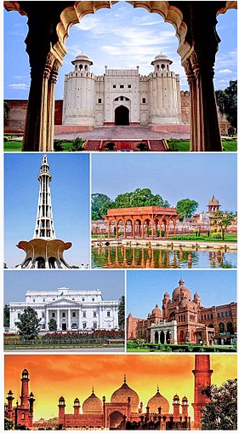
INTRODU CTION OF LAHORE CITY
Lahore (/ləˈhɔːr/; Punjabi: لہور; Urdu: لاہور‎, pronounced [lɑːˈɦɔːr]) is the capital of the Pakistani province of Punjab. Lahore is the country's second-most populous city and is one of Pakistan's wealthiest cities, with an estimated GDP of $58.14 billion (PPP) as of 2015.Lahore is the largest city, and historic cultural centre of the Punjab region, and one of Pakistan's most socially liberal, progressive and cosmopolitan cities.
Following independence in 1947, Lahore was declared capital of Pakistan's Punjab province.
Lahore exerts a strong cultural influence over Pakistan. Lahore is a major center for Pakistan's publishing industry, and remains the foremost center of Pakistan's literary scene. The city is also a major centre of education in Pakistan, with some of Pakistan's leading universities based in the city. Lahore is also home to Pakistan's film industry, Lollywood, and is a major centre of Qawwali music. The city also hosts much of Pakistan's tourist industry with major attractions including the Walled City, the famous Badshahi and Wazir Khan mosques and Sikh shrines. Lahore is also home to the Lahore Fort and Shalimar Gardens, both of which are UNESCO World Heritage Sites. LHR_LATITUDE = '31.520370‘ LHR_LONGITUDE = '74.358749'
(Source:https://en.wikipedia.org/wiki/Lahore))

Slide 4
AIM
To identify venues in Lahore, Pakistan based on their rating and average prices.
We identify various venues in the city of Lahore, Pakistan using Foursquare API and Zomato API to help visitors select the restaurants that suit them the best.
Helpful for User, whenever a user is visiting a city they start looking for places to visit during their stay.
Primarily look for places based on the venue ratings across all venues and the average prices such that the locations fits in their budget.
We will identify places that are fit for various individuals based on the information collected from the two APIs and Data Science.
Once we have the plot with the venues, any company can launch an application using the same data and suggest users such information.

Slide 5
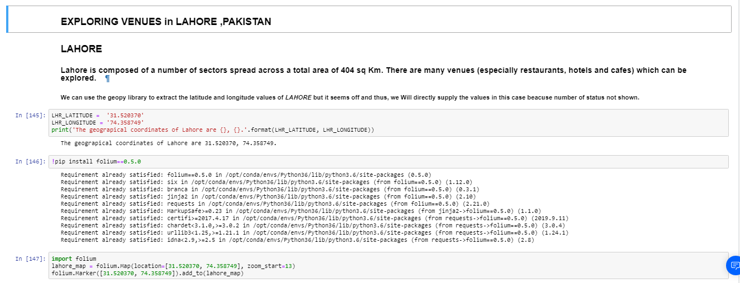
implematation

Slide 6
Data Collection from APIs
Take a look at Lahore,Pakistan on the Map using the folium library.
Fetch the data from two different APIs.
1.Foursquare API: We will use the Foursquare API to fetch venues in Chandigarh starting from the middle upto 44 Kilometers in each direction.
2.Zomato API: The Zomato API provides information about various venues including the complete address, user ratings, price for two people, price range and a lot more.

Slide 7
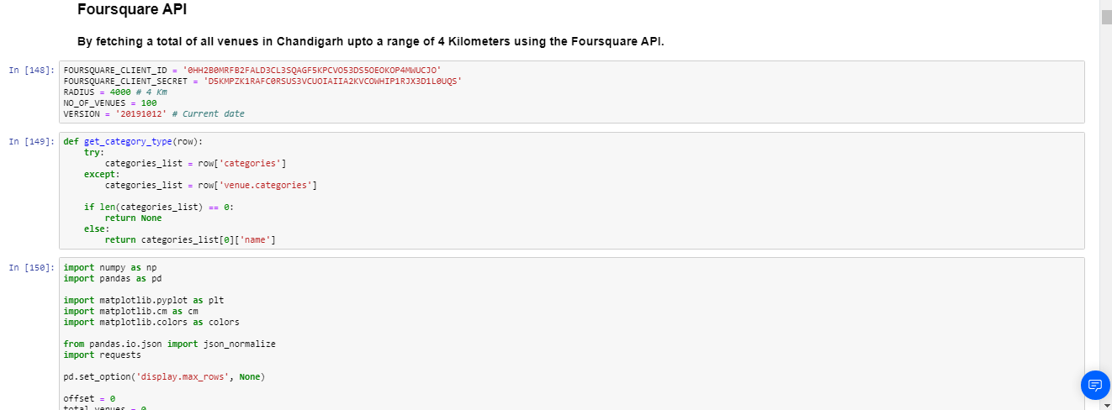
FOURSQUARE API IMPLEMENTATION

Slide 8
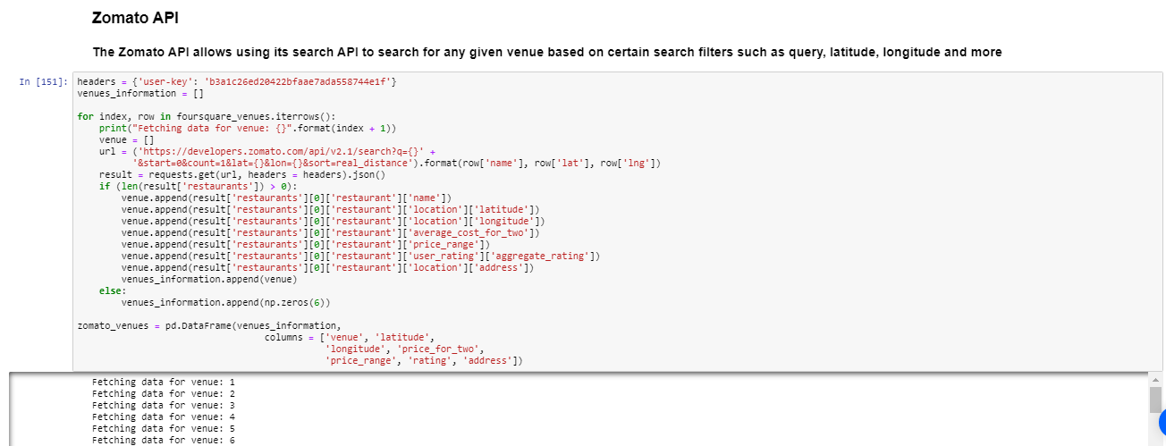
zomato API IMPLEMENTATION

Slide 9
DATA CLEANING
The data from multiple resources might not always align. Thus, it is important to combine the data retrieved from multiple resources properly.

Slide 10
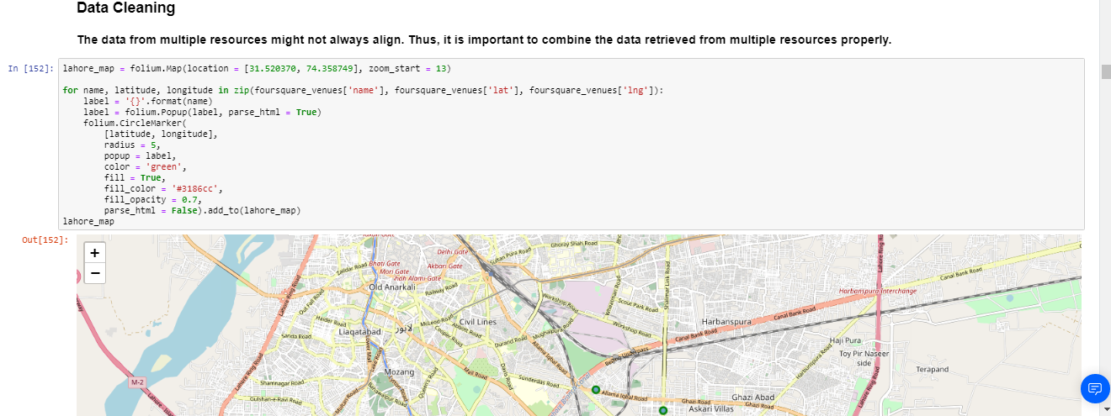
DATA CLEANING

Slide 11
Methodology
This project aims at identifying the venues in Lahore, Pakistan based on their rating and average costs.
This would enable any visitor to identify the venues he/she wants to visit based on their rating and cost preference.
As a first step, we retrieved the data from two APIs (Foursquare and Zomato).
We extract venue information from the center of Lahore, Pakistan up-to a distance of 4 Km. The latitude and longitude values are then used to fetch venue rating and price from Zomato.

Slide 12
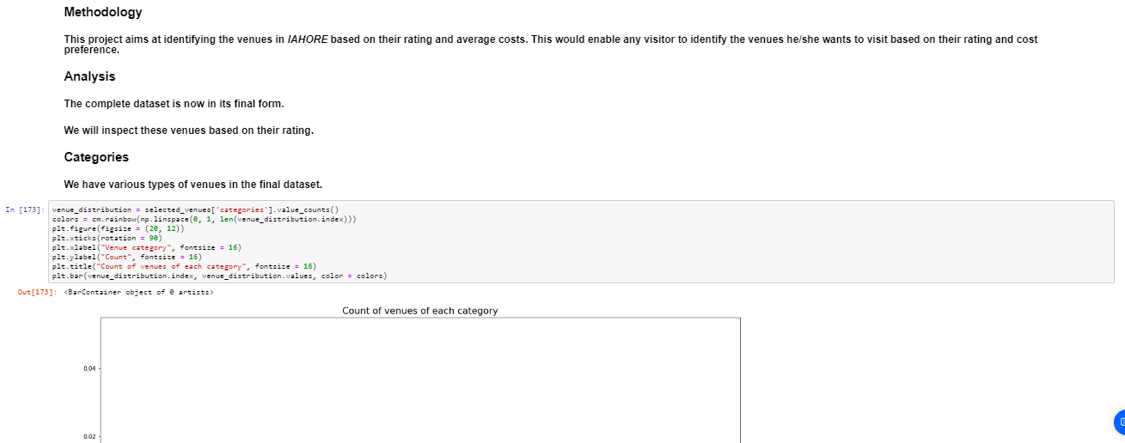
Methodology

Slide 13
Analysis
We will inspect these venues based on their rating.
The rating of a venue are based on user reviews and belongs to a range from 1 to 5.
We will also analyze the venues based on their price per person as well as the price range.
Categories
Rating
Price
Clustering

Slide 14
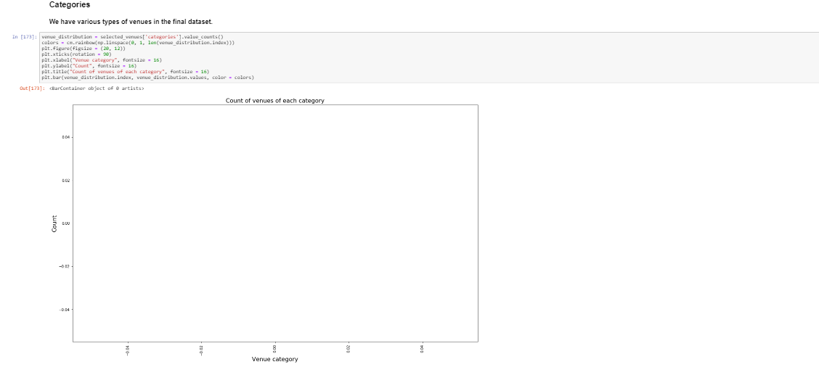
Analysis
Categories

Slide 15
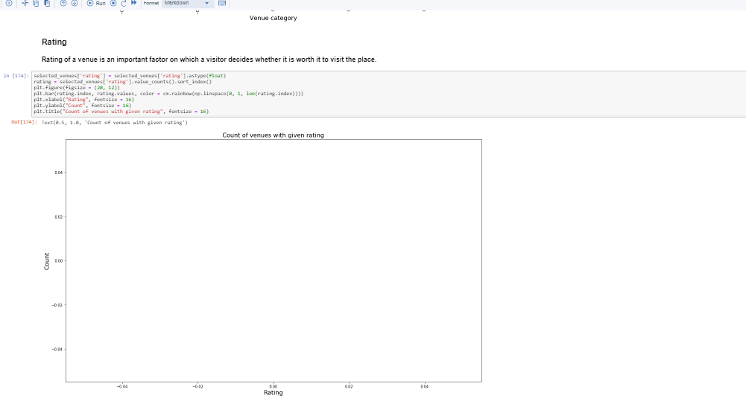
Analysis
Rating

Slide 16
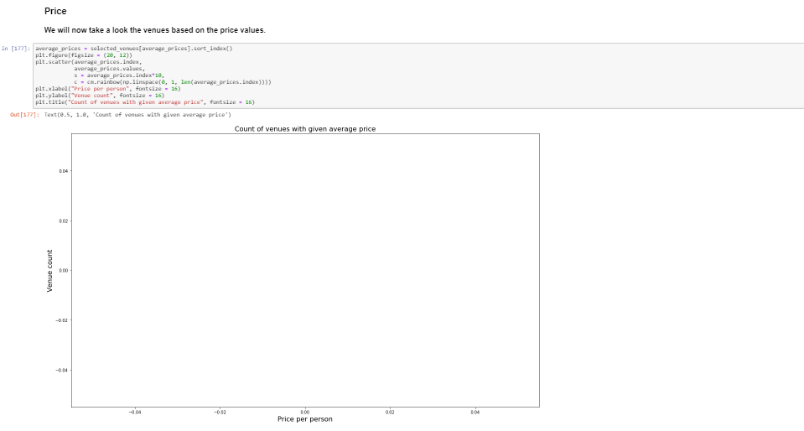
Analysis
Price

Slide 17
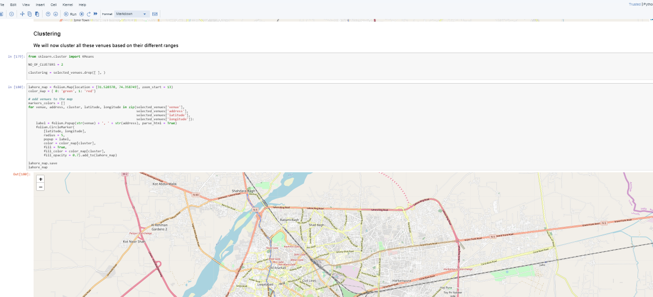
Analysis
Clustering

Slide 18
Conclusion
Purpose of this project was to explore the places that a person visiting Lahore, Pakistan could visit.
The venues have been identified using Foursquare and Zomato API and have been plotted on the map.
The map reveals that there are major areas a person can visit: Old Lahore Sector , New Lahore Sector & Industrial area.
Based on the visitor's venue rating and price requirements, he/she can choose amongst the three places.

Slide 19
RESULT
Based on our analysis above, we can draw a number of conclusions that will be useful to aid any visitor visiting the city of Lahore, Pakistan.
After collecting data from the Foursquare and Zomato APIs, we got a list of 120 different venues.
However, not all venues from the two APIs were identical. Hence, we had to inspect their latitude and longitude values as well as names to combine them and remove all the outliers. This resulted in a total venue count of 167.

Slide 20
RECOMENDATAIONS
The following analysis can be improved with following extensions:
In the Locality itself, it can also be computed the distance between all the venues in order to find a place with the most number of potential customers.
Using smaller geographical areas like Neighborhoods could improve the accuracy for the scores.

Slide 21
FUTURE WORK
A company can use this information to build up an online website/mobile application, to provide users with up to date information about various venues in the city based on the search criteria (name, rating and price).

Slide 22

EXPLORING VENUES IN LAHORE (PAKISTAN)
AMIN NADIM
OCTOBER 2019

